Slide 1
TCL & Related

Slide 2
Transactions
logical work unit that performs one or more activities. SQL’s save/undo button.
ACID
Atomicity, Consistency, Isolation, Durability
Transaction has two outcomes: committed or rolled back.
@@TRANCOUNT function returns the number of BEGIN TRANSACTION statements in the current session and we can use this function to count the open local transaction numbers

Slide 3
Transactions
Autocommit Transaction: the default transaction for the SQL Server. Each T-SQL statement is evaluated as a transaction and committed or rolled back according to their results. The successful/failed statements are committed/rolled back accordingly
Implicit transaction: enables to SQL Server to start an implicit transaction for every DML statement but explicit commit or rollback commands are needed at the end of the statements
Explicit transaction: define a transaction exactly with the starting and ending points of the transaction
Batch-scoped transactions: Only for Multiple Active Result Sets scenario, not very relevant to DE

Slide 4
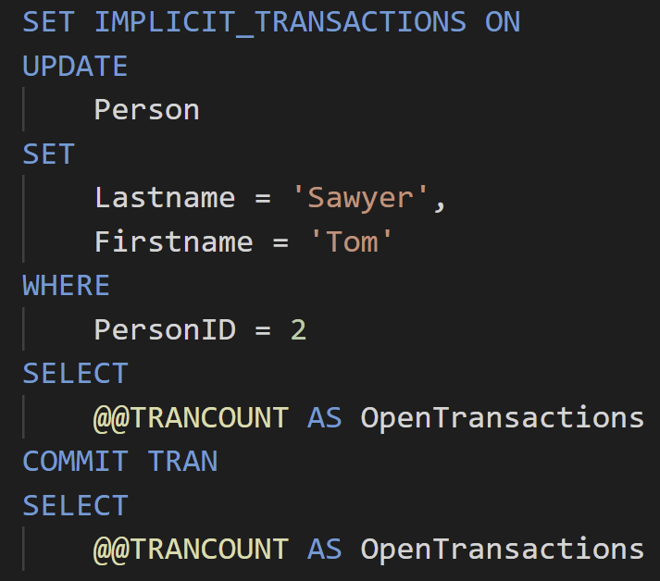
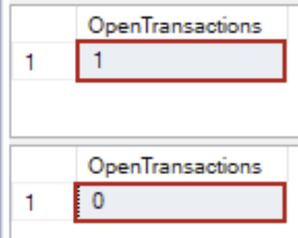
Transactions
Implicit transaction
enable the IMPLICIT_TRANSACTIONS option to define an implicit transaction
@@TRANCOUNT is a system variable

Slide 5
Transactions
Explicit transaction
use the BEGIN TRANSACTION/TRAN command to define an explicit transaction, which identifies the starting point of the explicit transaction.
transaction_name: name of the transaction
@trans_var option: user-defined variable that holds the transaction name
try to keeps transactions short, as related resources will be locked(depending on the isolation level) after BEGIN TRAN

Slide 6
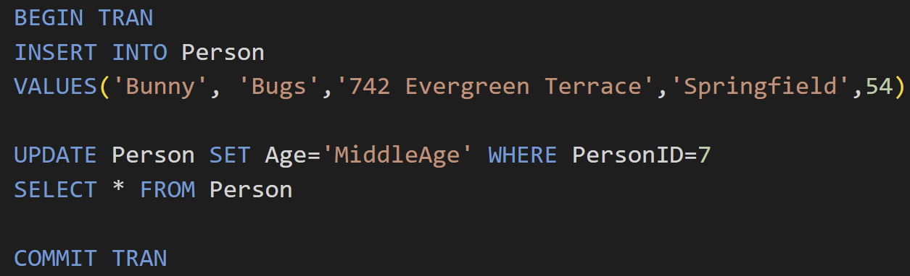
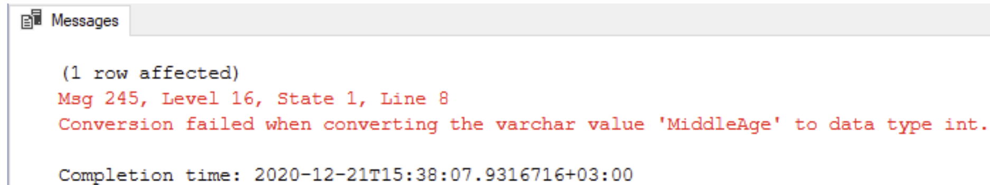
Transactions
AUTO ROLLBACK
we have seen this in action many times before

Slide 7
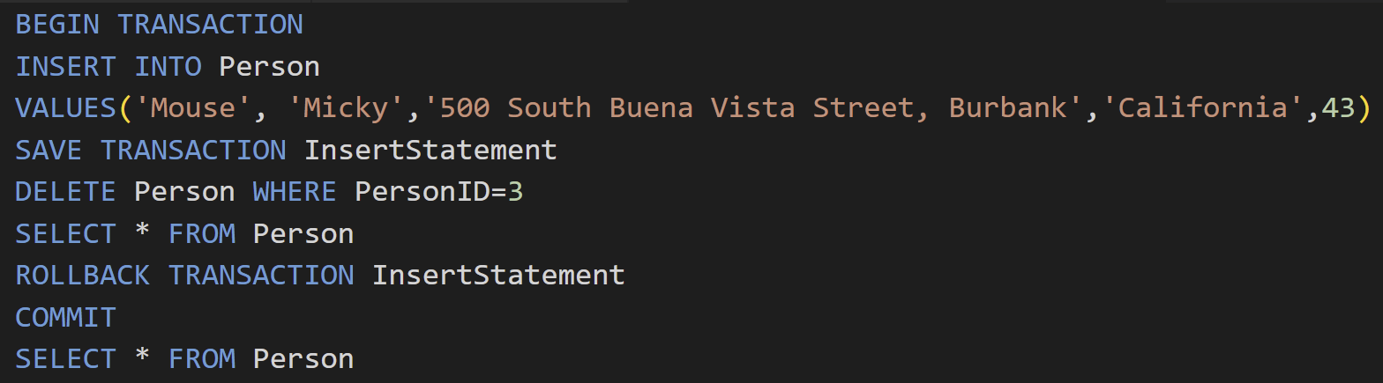
Transactions
SAVE TRANSACTION
allow us to roll back only part of a transaction

Slide 8
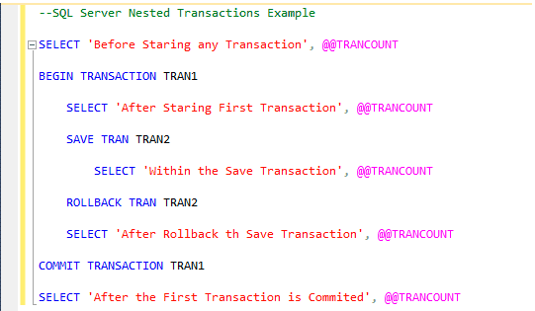
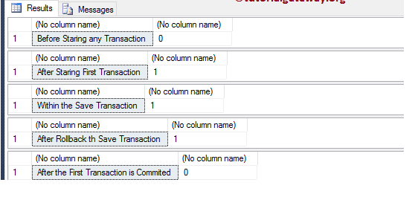
Transactions
Nested tran

Slide 9
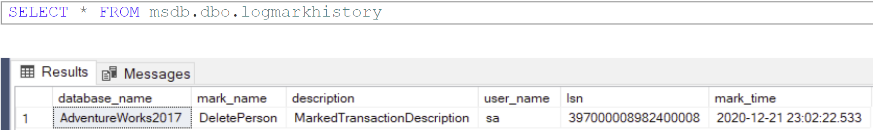
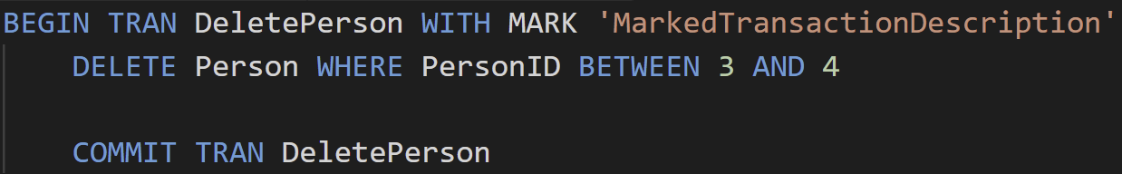
Transactions
Marked transactions
Will mark the name of the transaction in the log file, mostly for data recovery purposes
logmarkhistory table in msdb stores details about each marked transactions that have been committed
STOPATMARK rolls forward to the mark and includes the marked transaction in the roll forward
STOPBEFOREMARK rolls forward to the mark and excludes the marked transaction from the roll forward

Slide 10
Transactions
Additional notes
commit in a nested trans will not actually make changes permanent, only the outermost commit will.
rollback will roll back all inner transactions to the outermost begin tran
ROLLBACK TRANSACTION transaction_name will allow you to rollback specific transactions, regardless of save points

Slide 11
Concurrency in SQL Server
Typically not a part of a Data Engineer’s responsibility
Mostly for dedicated SQL Developers and DBA(Database Admin)
Does come up very occasionally in interviews
You don’t have to have a deep understanding, but some basic knowledge is required.

Slide 12
Concurrency Issues
Dirty Read
occurs when another process reads the changed, but uncommitted data.
For instance, if one process has changed data but not committed it yet, another process is able to read the same data. This leads to the inconsistent state for the reader.
Lost Updates
occurs when two processes try to manipulate the same data simultaneously. This problem can lead to data loss, or the second process might overwrite the first process’s change.

Slide 13
Concurrency Issues
Non-repeatable Reads
occurs when one process is reading the data, and another process is writing the data. In non-repeatable reads, the first process reading the value might get two different values, as the changed data is read a second time because the second process changes the data.
Phantom Reads
If two same queries executed by two users show different output, then it would be a Phantom Read problem.
For instance, If user A select a query to read some data, at the same time the user B insert some new data but the user A only get able to read the old data at the first attempt, but when user A re-query the same statement then he/she gets a different set of data.

Slide 14
Concurrency Control
Pessimistic concurrency control: use locks, low risk of rolling back transactions, high possibility of waiting locks. Locks are system automatic.
Optimistic concurrency control: use row versioning, high risk of rolling back transactions, low on waiting times

Slide 15
Optimistic concurrency control
“Let’s not use too many locks and hope for the best”
the readers cannot block writers, and the writers cannot block readers, but the writer can block another writer.
When a user updates data, the system checks to see if another user changed the data after it was read. If another user updated the data, an error is raised. Typically, the user receiving the error rolls back the transaction and starts over.
Mainly uses timestamps to check the version of data, when committing, newest version will be used, others will need to roll back.

Slide 16
Pessimistic concurrency control
“Let’s be careful and try to avoid concurrency issues”
After a user performs an action that causes a lock to be applied, other users cannot perform actions that would conflict with the lock until the owner releases it.
A system of locks prevents users from modifying data in a way that affects other users.

Slide 17
Isolation Levels
Read Uncommitted
Read Committed(system default)
Repeatable Read
Serializable
Snapshot

Slide 18
Isolation levels
Snapshot
Snapshot follows the optimistic model of concurrency
avoids most locking and blocking by using row versioning.
When data is modified, the committed versions of affected rows are copied to tempdb and given version numbers. This operation is called copy on write and is used for all inserts, updates and deletes using this technique.
When another session reads the same data, the committed version of the data as of the time the reading transaction began is returned.

Slide 19
Isolation levels
Read Uncommitted
the first level of isolation, and it comes under the pessimistic model of concurrency.
In Read Uncommitted, one transaction is allowed to read the data that is about to be changed by the commit of another process.
Read Uncommitted allows the dirty read problem.

Slide 20
Isolation levels
Read committed (system default)
This is the second level of isolation and also falls under the pessimistic model of concurrency.
In the Read Committed, we are only allowed to read data that is committed, which means this level eliminates the dirty read problem.

Slide 21
Isolation levels
Repeatable Read
similar to the Read Committed level and eliminates the Non-Repeatable Read problem.
In this level, the transaction has to wait till another transaction's update or read query is complete. But if there is an insert transaction, it does not wait for anyone. This can lead to the Phantom Read problem.

Slide 22
Isolation levels
Serializable
This is the highest level of isolation in the pessimistic model.
In this level of isolation, we can ask any transaction to wait until the current transaction completes.
By implementing this level of isolation, we can prevent the Phantom Read problem.

Slide 23
Locks
Exclusive (X)
will ensure that a page or row will be reserved exclusively for the transaction that imposed the exclusive lock, as long as the transaction holds the lock.
Shared (S)
will reserve a page or row to be available only for reading
can be imposed by several transactions at the same time.
will allow write operations, but no DDL changes will be allowed

Slide 24
Locks
Update (U)
similar to an exclusive lock but is designed to be more flexible in a way.
can be imposed on a record that already has a shared lock. In such a case, the update lock will impose another shared lock on the target row. Once the transaction that holds the update lock is ready to change the data, the update lock (U) will be transformed to an exclusive lock (X).

Slide 25
Locks
Intent (I)
used by a transaction to inform another transaction about its intention to acquire a lock.
The purpose of such lock is to ensure data modification to be executed properly by preventing another transaction to acquire a lock on the next in hierarchy object.
will not allow other transactions to acquire the exclusive lock on that table.
There are six different types of Intent locks… skipped for our discussion

Slide 26
Locks
Schema (Sch)
Schema modification lock (Sch-M) -> for DDL
will be acquired when a DDL statement is executed, and it will prevent access to the locked object data as the structure of the object is being changed.
Schema stability lock (Sch-S) -> for DML
will be acquired while a schema-dependent query is being compiled and executed and execution plan is generated. This particular lock will not block other transactions to access the object data and it is compatible with all lock modes except with the schema modification lock (Sch-M).

Slide 27
Locks
Bulk update (BU)
designed to be used by bulk import operations.
When a bulk update lock is acquired, other processes will not be able to access a table during the bulk load execution.
However, a bulk update lock will not prevent another bulk load to be processed in parallel.

Slide 28
Locks
Ironically, one of the most frequently used query hints is WITH(NOLOCK)
Similar to the READ UNCOMMITTED isolation level
For when you just want to read some data, and doesn’t care too much about the absolute accuracy of the data.

Slide 29
Deadlock
Happens on multiple transactions
Resolved automatically – System will let the more expensive transaction go through and rollback the other one

Slide 30
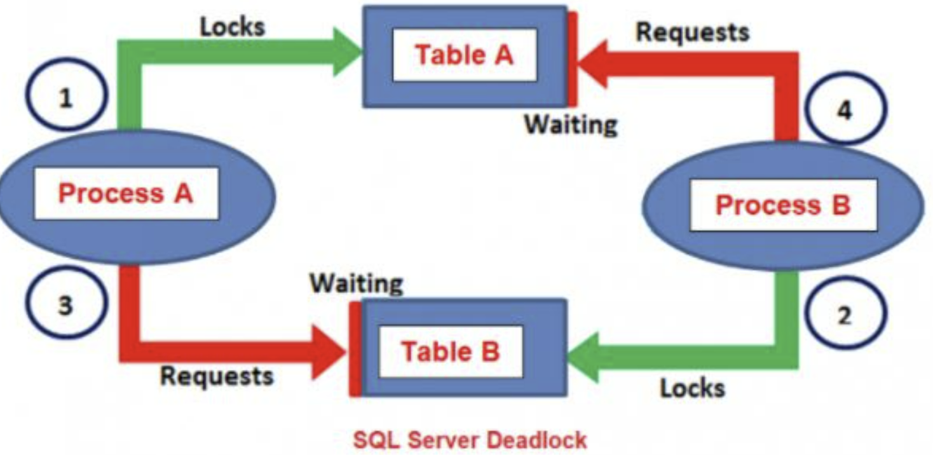
Deadlock
Proc A,B both needs table A and B
Proc A placed lock on TA, Proc B placed lock on TB
Proc A waits for Proc B to finish, Proc B waits for Proc A to finish
Neither can finish because the other table has been locked

Slide 31
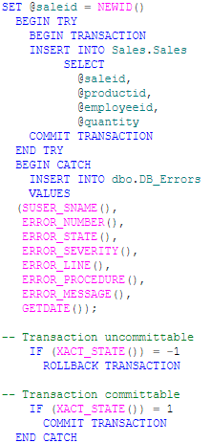
Error Handling
Error handling is done by using try catch.

Slide 32
Programmability

Slide 33
Stored Procedure
Stored Procedure improves the performance and code reusability in SQL Server(details in next slide)
Can return a value, a dataset, execute a change or calling other procedures.
Can accept input parameters and output parameters.
Can be explicitly called by SQL (using EXEC) or by outside environment (Python Lib, ADO.NET, Azure Data Factory, etc)

Slide 34
Stored Procedure
Why use Stored Procedures?
easily modified with the ALTER PROCEDURE statement.
Reusable
Secure: Stored procedures reduce the threat by eliminating direct access to the tables. The code for SPs can also be encrypted
Reduced network traffic: When using stored procedures at the application level, only the procedure name and parameters are passed over the network instead of the whole T-SQL code.
Performance: The SQL Server stored procedure when executed for the first time creates a plan and stores it in the buffer pool so that the plan can be reused when it executes next time.(might be a bad thing if input is very different from the input used to generate the plan)

Slide 35
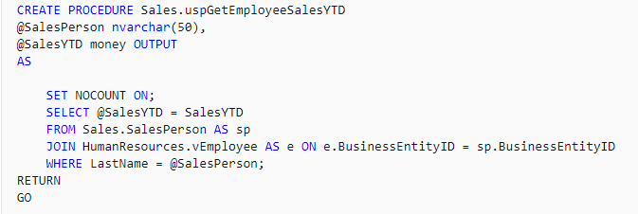
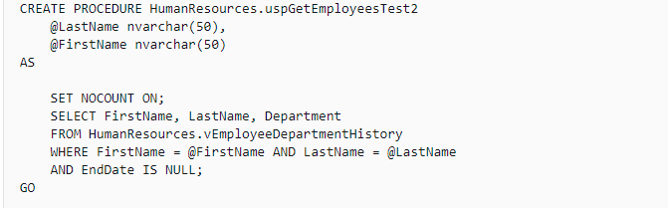
Create Stored Procedure

Slide 36
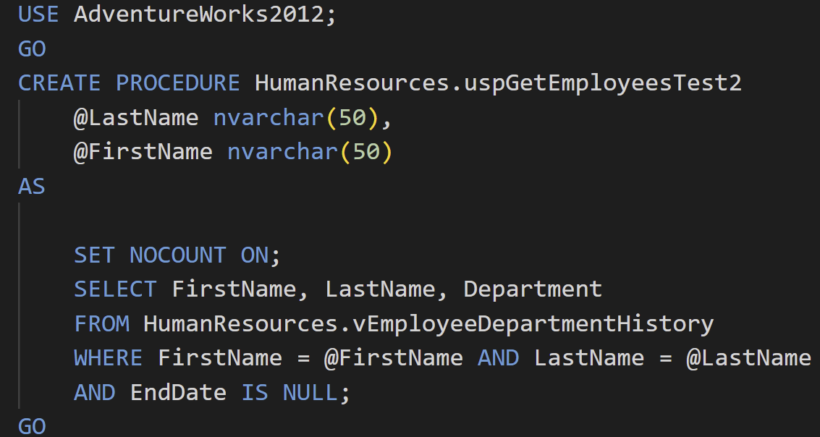
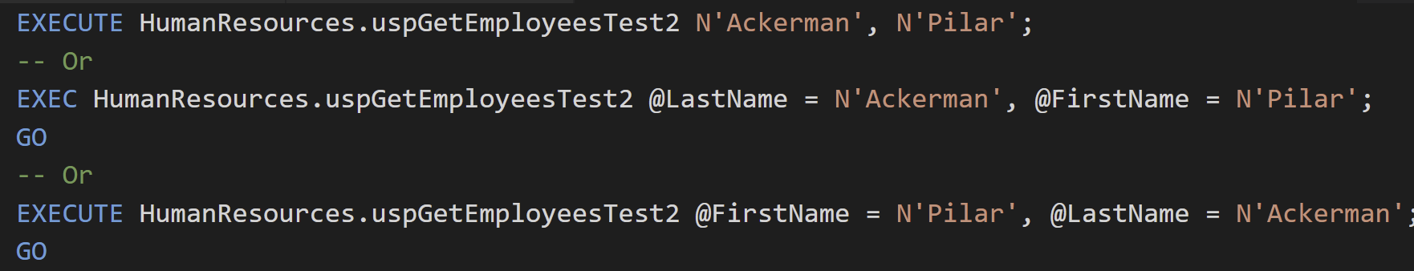
Execute Stored Procedure

Slide 37
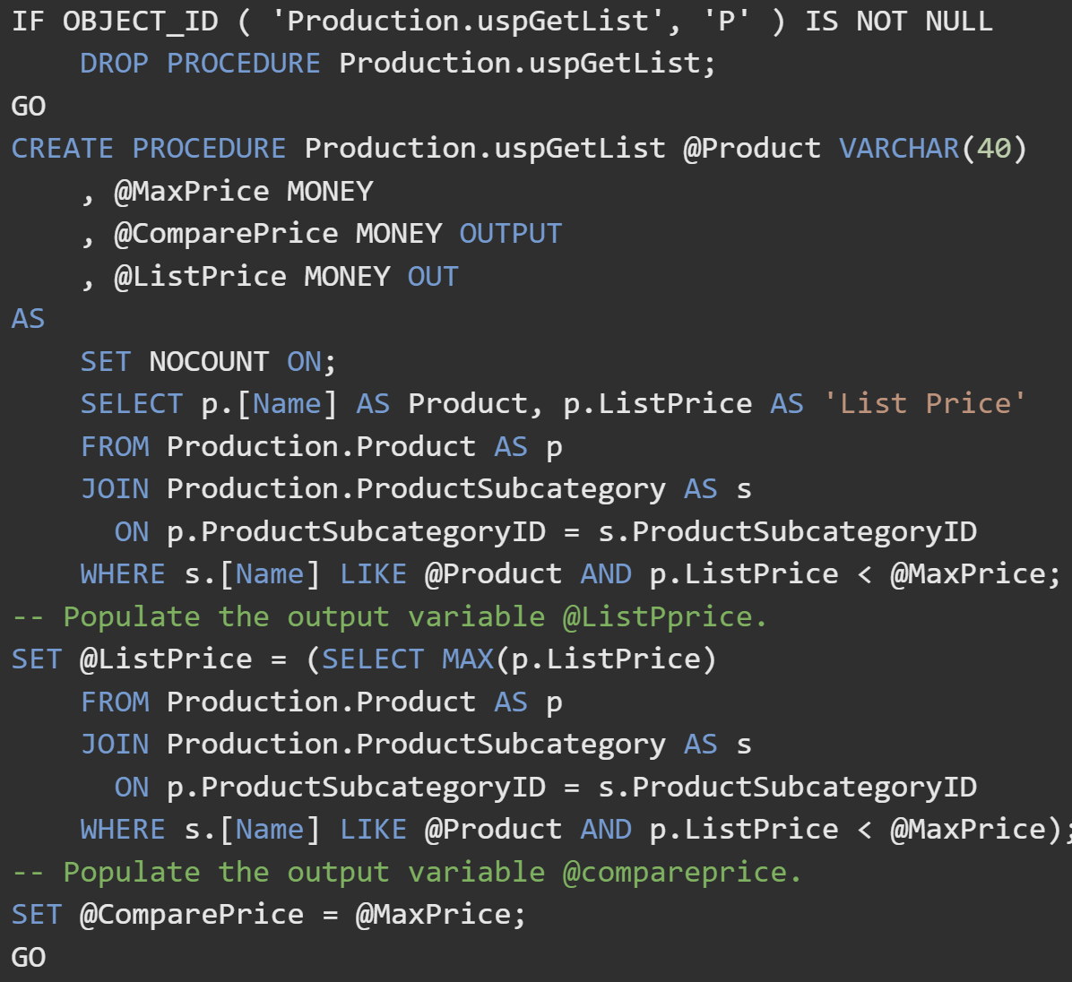
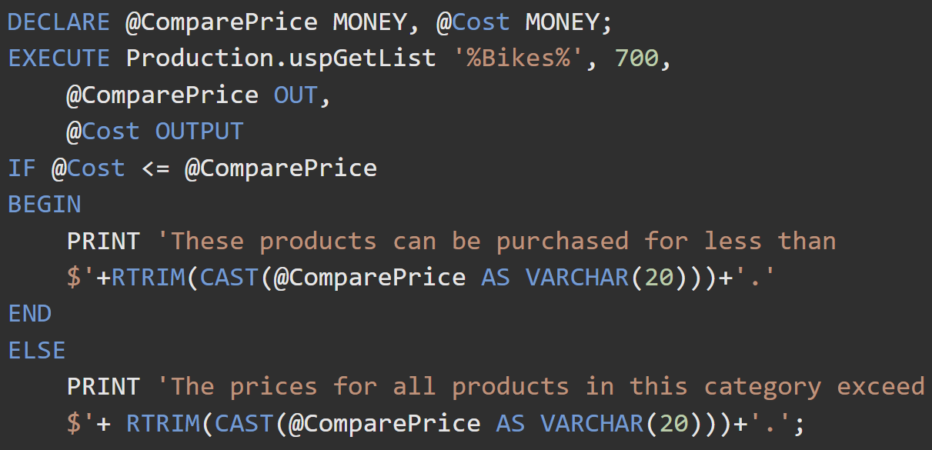
Execute Stored Procedure

Slide 38
Functions
routines that accept parameters, perform an action, and return the result of that action as a value(scalar value or a result set).
Function can take 0 to multiple input parameters, but no out parameters. Function has to return something.
Functions does supports error handling.
Can have SCHEMABINDING, which prevents the schema modification of objects the function is dependent upon.
Could deterministic or nondeterministic
deterministic: same output every time for the same input
nondeterministic: different outputs for the same input.

Slide 39
Functions
Three types of functions
Scalar Function
return a single data value of the type defined in the RETURNS clause. The return type can be any data type except text, ntext, image, cursor, and timestamp.
Table-Valued Functions
return a table data type.
System Functions
provides many system functions that you can use to perform a variety of operations. They cannot be modified.

Slide 40
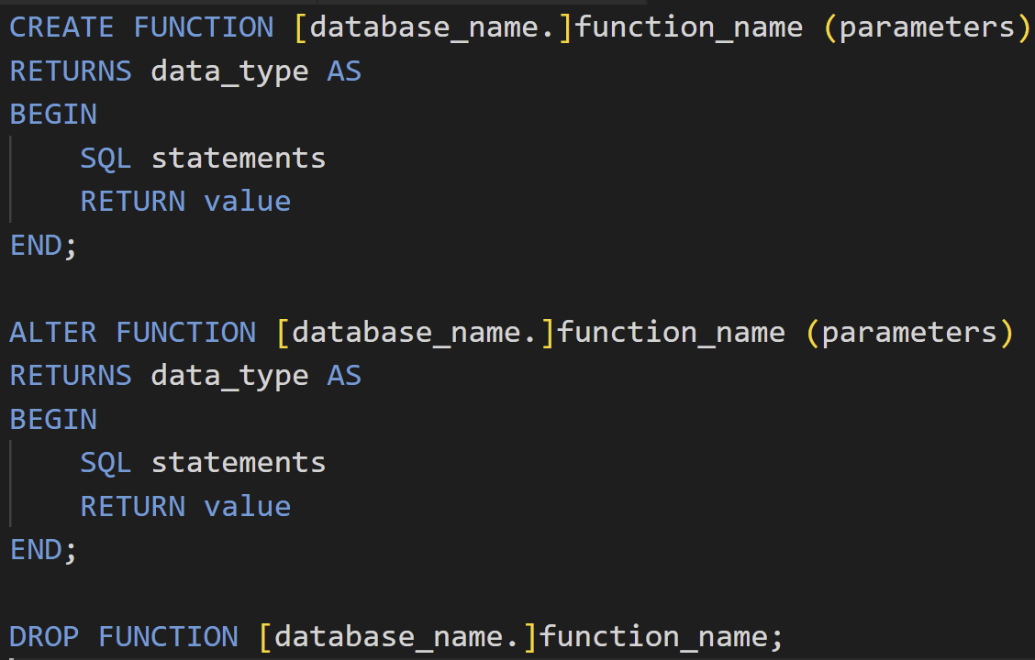
User Defined Functions
General Syntax

Slide 41
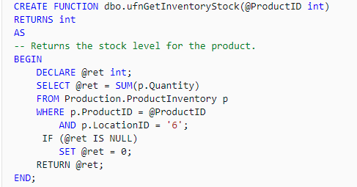
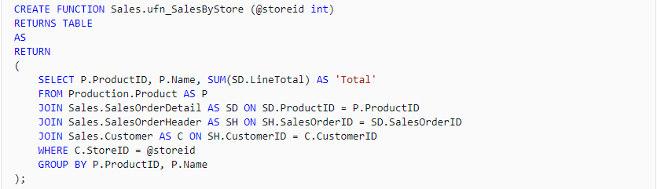
User Defined Functions

Slide 42
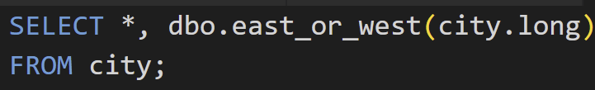
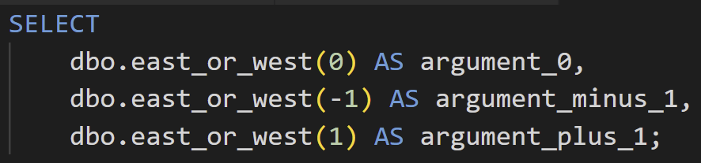

Execute User Defined Functions

Slide 43
Stored Procedure vs Functions
Stored Procedure (SP) | Function (UDF - User Defined)
SP can return zero, single or multiple values. | Function must return a single value (which may be a scalar or a table).
We can use transaction in SP. | We can't use transaction in UDF.
SP can have input/output parameter. | Only input parameter.
We can call function from SP. | We can't call SP from function.
We can't use SP in SELECT/ WHERE/ HAVING statement. | We can use UDF in SELECT/ WHERE/ HAVING statement.
We can use exception handling using Try-Catch block in SP. | We can't use Try-Catch block in UDF.
Can’t be used with APPLY | Can be called in APPLY
DML is fine and common | Can’t use DML. Only DQL
Can use temp tables | Can only use table variables
Procedure can use when we want instead is to group a possibly- complex set of SQL statements | Function can use when we want to compute and return a value for use in other SQL statements

